Slide 1
HNDIT2302 IT Project Management
Project Scope Management

Slide 2
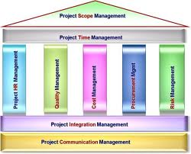
Project Scope Management

Slide 3
Project Scope Management
Project Scope Management includes the processes required to ensure that the project includes all the work required, and only the work required, to complete the project successfully.
Major project scope management processes:
Initiation
Scope Planning
Scope Definition
Scope Verification
Scope Change Control

Slide 4
What is Project Scope Management?
Scope refers to all the work involved in creating the products of the project and the processes used to create them.
A deliverable is a product produced as part of a project, such as hardware or software, planning documents, or meeting minutes.
Project scope management includes the processes involved in defining and controlling what is or is not included in a project.

Slide 5
Project Scope Management Processes
Scope planning: Deciding how the scope will be defined, verified, and controlled.
Scope definition: Reviewing the project charter and preliminary scope statement and adding more information as requirements are developed and change requests are approved.
Creating the WBS: Subdividing the major project deliverables into smaller, more manageable components.
Scope verification: Formalizing acceptance of the project scope.
Scope control: Controlling changes to project scope.

Slide 6
Scope Planning and the Scope Management Plan
The scope management plan is a document that includes descriptions of how the team will prepare the project scope statement, create the WBS, verify completion of the project deliverables, and control requests for changes to the project scope.
Key inputs include the project charter, preliminary scope statement, and project management plan.

Slide 7
Project Charters
After deciding what project to work on, it is important to formalize projects
A project charter is a document that formally recognizes the existence of a project and provides direction on the project’s objectives and management
Key project stakeholders should sign a project charter to acknowledge agreement on the need and intent of the project

Slide 8
Project Charter - Sample
Project Title :
Project Start Date : Project Finish Date:
Project Manager :
Project Objectives :
Approach :
ROLES AND RESPONSIBILITES
Sign-off :
Comments :
Name | Role | Responsibility

Slide 9
Scope Definition and the Project Scope Statement
The preliminary scope statement, project charter, organizational process assets, and approved change requests provide a basis for creating the project scope statement.
As time progresses, the scope of a project should become clearer and more specific.

Slide 10
Scope Planning and the Scope Statement
A scope statement is a document used to develop and confirm a common understanding of the project scope. It should include
a project justification
a brief description of the project’s products
a summary of all project deliverables
a statement of what determines project success

Slide 11
Scope Statement - Sample
Project Name :
Date : Prepared by:
Project Justification :
Product characteristics and requirements :
Product user acceptance criteria :
Summery of project deliverables :

Slide 12
Creating the Work Breakdown Structure (WBS)
A WBS is a deliverable-oriented grouping of the work involved in a project that defines the total scope of the project.
A WBS is a foundation document that provides the basis for planning and managing project schedules, costs, resources, and changes.
Decomposition is subdividing project deliverables into smaller pieces.

Slide 13
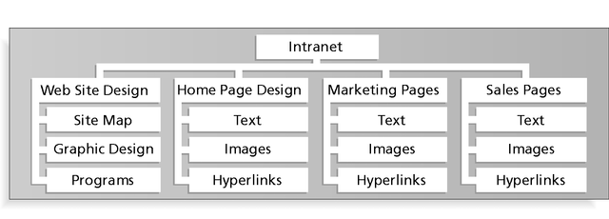
Sample Intranet WBS Organized by Product

Slide 14
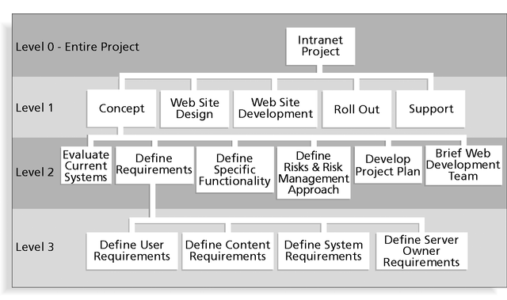
Sample Intranet WBS Organized by Phase

Slide 15
Intranet WBS in Tabular Form
1.0 Concept
1.1 Evaluate current systems
1.2 Define requirements
1.2.1 Define user requirements
1.2.2 Define content requirements
1.2.3 Define system requirements
1.2.4 Define server owner requirements
1.3 Define specific functionality
1.4 Define risks and risk management approach
1.5 Develop project plan
1.6 Brief Web development team
2.0 Web Site Design
3.0 Web Site Development
4.0 Roll Out
5.0 Support

Slide 16
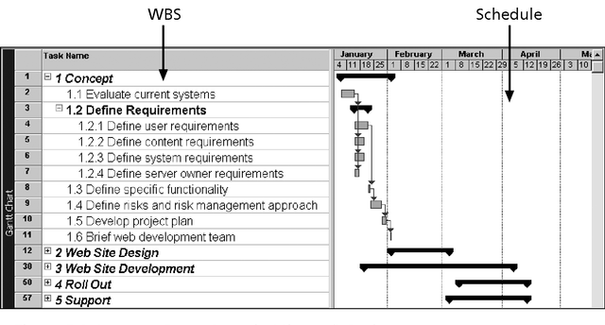
Intranet WBS and Gantt Chart

Slide 17
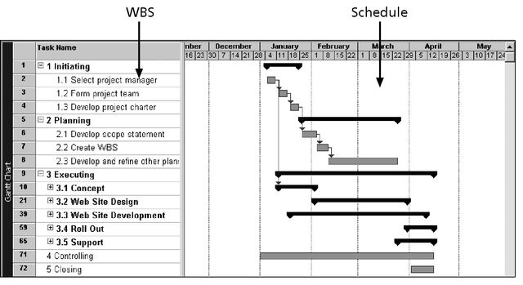
Intranet Gantt Chart Organized by Project Management Process Groups

Slide 18
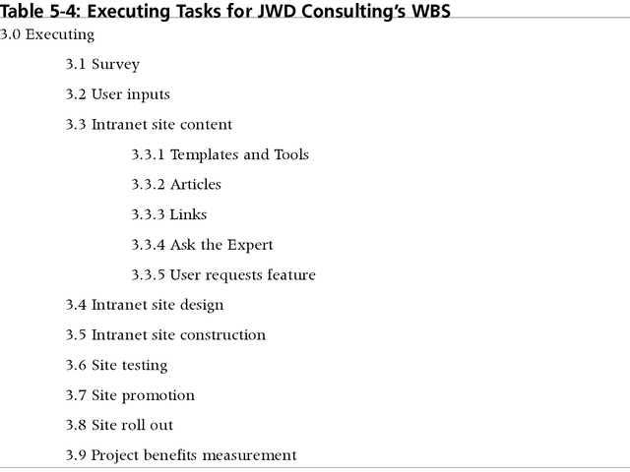
Executing Tasks for JWD Consulting’s WBS

Slide 19
Approaches to Developing WBSs
Guidelines: Some organizations, such as the DOD, provide guidelines for preparing WBSs.
Analogy approach: Review WBSs of similar projects and tailor to your project.
Top-down approach: Start with the largest items of the project and break them down.
Bottom-up approach: Start with the specific tasks and roll them up.
Mind-mapping approach: Write tasks in a non-linear, branching format and then create the WBS structure.

Slide 20
Creating the WBS - Top-down approach
In preparing a WBS, keep the following in mind:
Use any category that makes sense for your project.
Don’t be constrained by sequence
The diagram does not have to be symmetrical.
Each box is a summary of the boxes in the levels below it.
The final box in each branch must end in a product or deliverable.
The boxes in the lowest level are called work packages.
The sum total of boxes must represent the complete project.
The entire project team should be involved in developing the WBS.
When completed, you should review the work breakdown with the client and customers.

Slide 21
Scope Verification
Verifying scope involves formalizing acceptance of the project deliverables.
Key project stakeholders, such as the customer and sponsor for the project, inspect and then formally accept the deliverables during this process. If the deliverables are not acceptable, the customer or sponsor usually requests changes.
The main outputs of this process, therefore, are accepted deliverables and change requests.

Slide 22
Scope Control
Scope control involves controlling changes to the project scope.
Goals of scope control are to:
Influence the factors that cause scope changes.
Ensure changes are processed according to procedures developed as part of integrated change control.
Manage changes when they occur.
Variance is the difference between planned and actual performance.

Slide 23
Project Scope Management Summary

Slide 24
Suggestions for Improving User Input
Develop a good project selection process and insist that sponsors are from the user organization.
Place users on the project team in important roles.
Hold regular meetings with defined agendas, and have users sign off on key deliverables presented at meetings.
Deliver something to users and sponsors on a regular basis.
Don’t promise to deliver when you know you can’t.
Co-locate users with developers.

Slide 25
Suggestions for Reducing Incomplete and Changing Requirements
Develop and follow a requirements management process.
Use techniques such as prototyping, use case modeling, and JAD to get more user involvement.
Put requirements in writing and keep them current.
Create a requirements management database for documenting and controlling requirements.

Slide 26
Suggestions for Reducing Incomplete and Changing Requirements (cont’d)
Conduct adequate testing throughout the project life cycle.
Review changes from a systems perspective.
Emphasize completion dates to help focus on what’s most important.
Allocate resources specifically for handling change requests and enhancements (as NWA did with ResNet).

Slide 27
Using Software to Assist in Project Scope Management
Word-processing software helps create scope-related documents.
Spreadsheets help perform financial calculations and weighed scoring models, and help develop charts and graphs.
Communication software, such as e-mail and the Web, helps clarify and communicate scope information.
Project management software helps create a WBS, the basis for tasks on a Gantt chart.
Specialized software is available to assist in project scope management.

Slide 28
References
“Information Technology Project Management”, Kathy Schwalbe, sixth Edition, THOMSON Course Technology

